Slide 1

College of Science and Technology
School of ICT
Computer Science Department
Year 2
Lecturer: Muhayimana Odette
E-mail: muhayiodette06@gmail.com
Phone: 0788888571
CHAP1: Introduction to Database Management System
1

Slide 2

Learning outcomes
After completing this chapter, the reader will be familiar with the following concepts:
File based system vs. database approach
Data, information, Character, Field, database, type of database, query, database management system(DBMS), components of database management system, DBMS architecture
Data model
Data independence
DBMS languages
2

Slide 3
Data : Data is the result of a measurement, event or raw fact. Data can be of various forms such as: numbers, characters, symbols, images, audio etc., which can be processed by a computer. Example:Ali.
Information: Information is the data that has been processed to be meaningful to the person who receives it. Information is the knowledge derived from study, experience (by the senses), or instruction.
Example: Ali is the manager
Why do we need information?
To gain knowledge about the surroundings
To keep the system up to date
To know about the rules and regulations of society
To solve problems
To make decisions
Etc.

Slide 4
Difference between data and information
Data | Information
Data is raw fact | It is the processed form of data
It is not significant to a business | It is significant to a business
Data are atomic level piece of information | It is a collection of data
Data does not help in decision making | It help in decision making
e.g: Ali | e.g: Ali is the manager

Slide 5

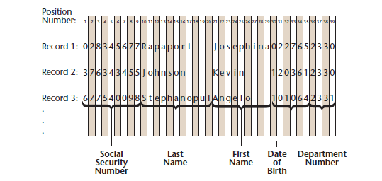
Traditional File Processing
Data can be maintained in one of two ways: the traditional file approach— which has no mechanism for tagging, retrieving, and manipulating data—and the database approach, which does have this mechanism. To appreciate the benefits of the database approach, you must keep in mind the inconvenience involved in accessing and manipulating data in the traditional file approach: program-data dependency, high data redundancy, and low data integrity.

Slide 6

Disadvantages
Program-Data dependency: The program is written according to the location of data. For example, suppose a programmer wants to retrieve and print out only the last name and department number of each employee from the above file. The programmer must clearly instruct the computer to first retrieve the data between position 10 and position 20.
Data redundancy: This means that the same values are duplicated in same or different files. For example, the employee detail is stored both in the department and in the main office.
No Data integrity: Integrity has to do with the correctness of data. For instance, when data is duplicated in two different files, it is difficult to ensure that it is correct in both files.

Slide 7

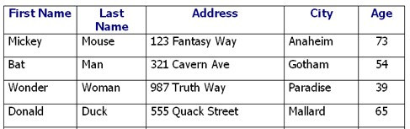
Database Approach
In the database approach, data is organized into entities. An entity is any object about which an organization chooses to collect data. Entities can be types of people, such as employees, students, or members of fan clubs; events, such as sales transactions, sports events, or theatre shows; or inanimate objects, such as inventoried or for-sale products, buildings, or minerals. In the context of data management,“entity” refers to all the occurrences sharing the same types of data.
Databases are more efficient (By using indexing, hashing and other optimization tools), Concurrent access to data is safer in databases, Data security is better

Slide 8

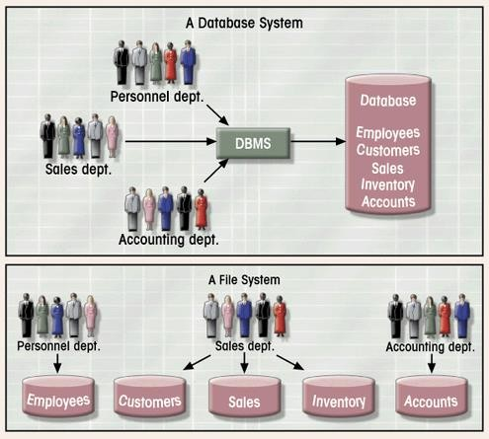
Database vs. File Systems

Slide 9
Character: The most basic logical data element is the character , which consists of a single alphabetic, numeric, or other symbol. You might argue that the bit or byte is a more elementary data element, but remember that those terms refer to the physical storage elements provided by the computer hardware.
Field: A field consists of a grouping of related characters. For example, the grouping of alphabetic characters in a person’s name may form a name field (or typically, last name, first name, and middle initial fields), and the grouping of numbers in a sales amount forms a sales amount field.

Slide 10
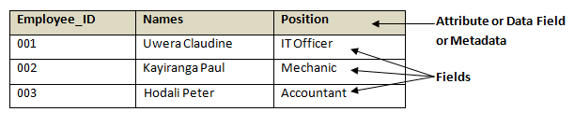
Attribute: Also referred to as data field, or property, or article, or metadata,
an attribute is the variable that describes the field.
*** In most papers including this one, the terms Attribute, Data Field and Field are used interchangeably. It is confusing, but this is another reality in appellation you have to cope with.
Record: A collection of related fields
File: Also called table or relation (in a specific case), a file is a collection of related records.
Database (DB): It is a collection of files (tables/relations), relationships, and queries. These files have no redundancy and have high integrity. (see Figure below)

Slide 11
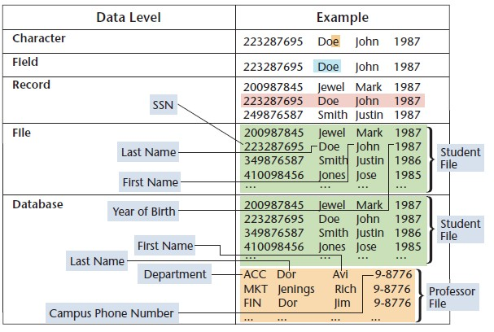
Query: A query is a message sent to the database instructing a data retrieval or manipulation. There as also queries that instruct the creation of data structures (containers of data).A file for instance is a data structure.

Slide 12
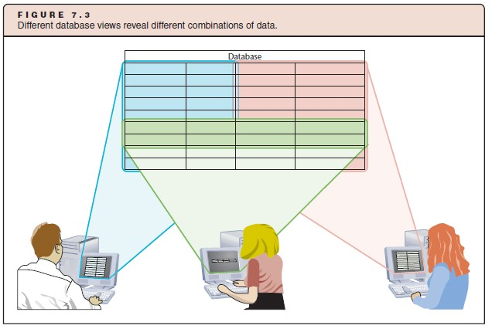
Queries are mostly used to retrieve data. This retrieval helps users to have different views of the database.

Slide 13
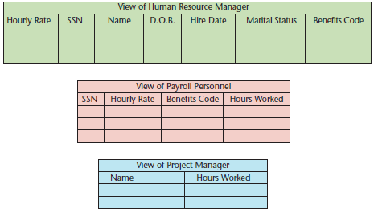
Database Application: The database application or most often the Application is a set of one or more computer programs that serves as an intermediary between the user and the database. The application reads or modifies data by sending queries to the database. The application also present data to users in the format of forms and reports. Application can be acquired from software vendors, and they are also frequently written (developed) in-house.

Slide 14
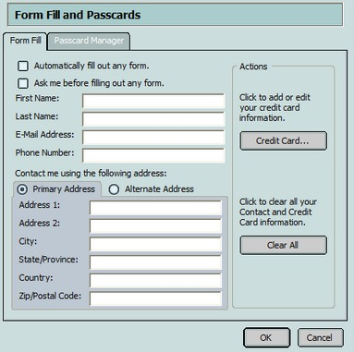
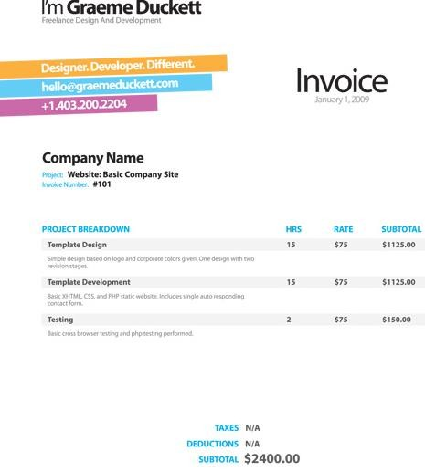
Example of Form
Example of Report

Slide 15
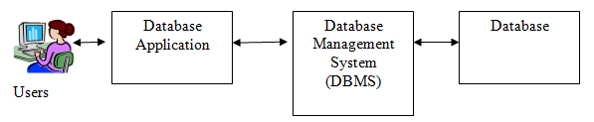
Database System: A database system is composed of the database, the
database management system (DBMS), the database application and end-users.

Slide 16

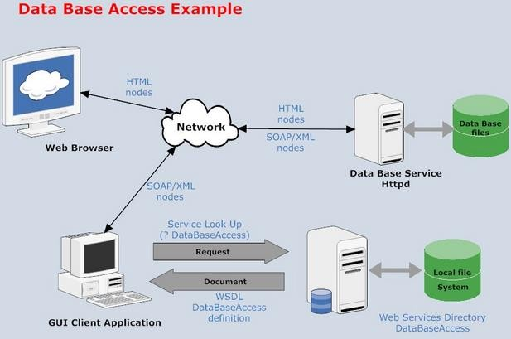
Database and Network
The database can be deployed locally in one machine just used by one user or distributed to many users through a network. The notion of database is almost always coupled with the notion of network because in enterprises databases are opened to many users. The application is installed in different client machines which are connected to the server machine where inside the database is installed. Several applications encoded in different programming languages can be connected to the same database.

Slide 17
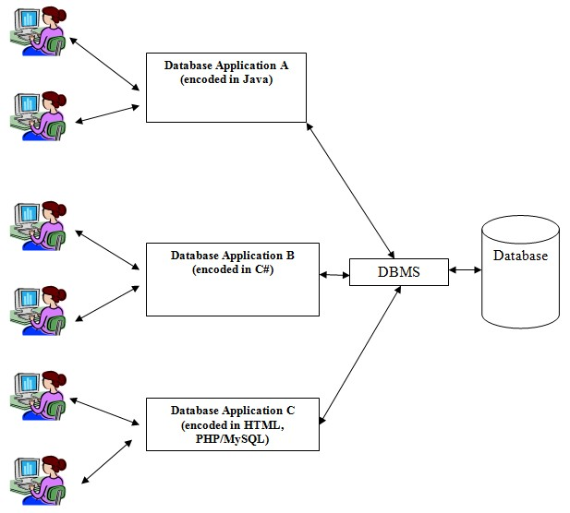

Slide 18

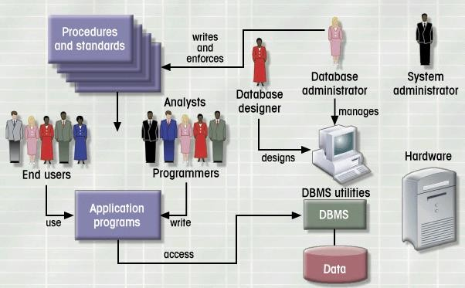
Database System Environment

Slide 19

Why Database?
Redundancy can be reduced
Inconsistency can be avoided
The data can be shared
Standards can be enforced
Security restrictions can be applied
Integrity can be maintained
Provision of data independence

Slide 20




The Essence (Quality of) of a Database
Organization of data
Efficient retrieval of data
Reliable storage of data
Maintaining the consistency of the data
Sharing data
Structuring the data

Slide 21


Example of databases
Airline Reservation System Database
List of flights
List of seats sold for each flight
List of passenger names
Concurrent access control (several sale agencies may sell a seat at the same time)
Fast search for a flight, passenger, connection, etc.
Restrict access to database (Security)

Slide 22

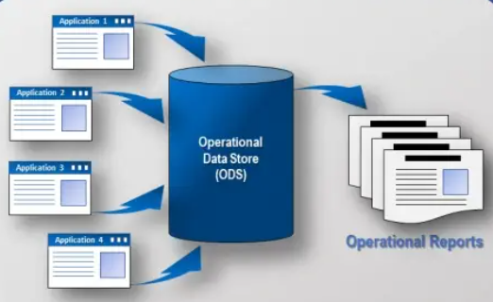
Types of Databases
There are various types of databases used in nowadays’ technology area, and each type has its strengths and weaknesses. Therefore, making the right choice of database for a particular use case should be done with more attention, considering data that is being stored and how it will be used.
Operational databases: They store detailed data needed to support the business processes and operations of a company. They are also called subject area databases (SADB), transaction databases , and production databases . Examples are a customer database, human resource database, inventory database, and other databases containing data generated by business operations.

Slide 23
Example:
In an online store, operational database is used to keep track of ongoing payments and record items.
For credit or debit card, accountants use the operational database because it must balance up to the last changes made on the cards.

Slide 24
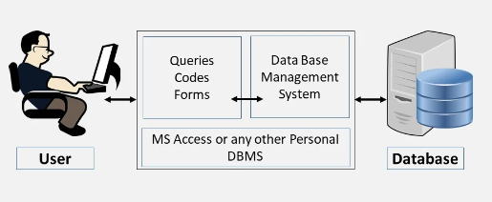
Personal database: it is a tool specifically designed to store, retrieve, and manage large amounts of data in both numeric and textual formats. It can be used by end users to manipulate lists of data as well as by other applications that need to store data for further processing. And it is relatively small for most of the cases because it is used for personal purposes. It is made up of one database and a single user.

Slide 25
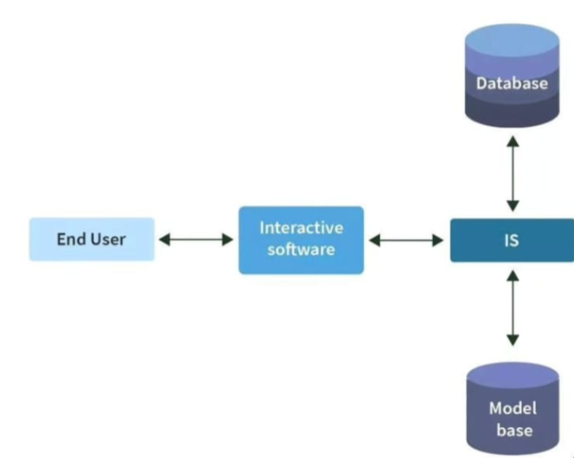
End user database: it is a type of database that allows an end-user to create, to store data, and manage data. It gives to an end-user a privilege to directly interact with and control the database and data stored on it; based on his/her responsibilities. For example, in different applications, the HR can have his/her responsibilities, and will be able to interact with the database according to his role, the same for programmers, depending on their role/responsibilities. Briefly. In End-users, based on their responsibilities, users will be categorized and be granted access to the database accordingly.

Slide 26
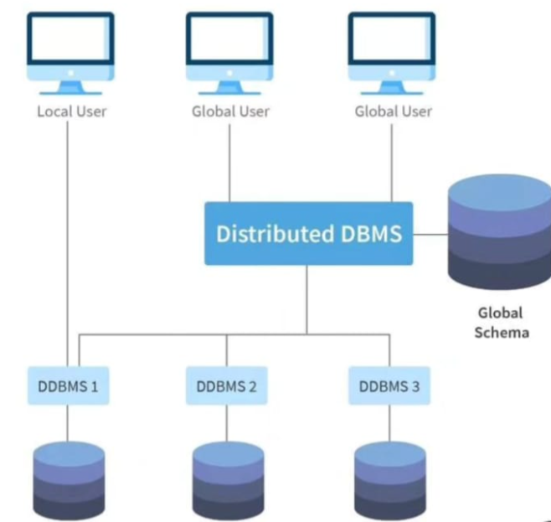
Distributed databases: Many organizations replicate and distribute copies or parts of databases to network servers at a variety of sites. These distributed databases can reside on network servers on the World Wide Web, on corporate intranets or extranets, or on other company networks. Distributed databases may be copies of any other type of database. Briefly, this type of database is made up of multiple databases and multiple users.

Slide 27
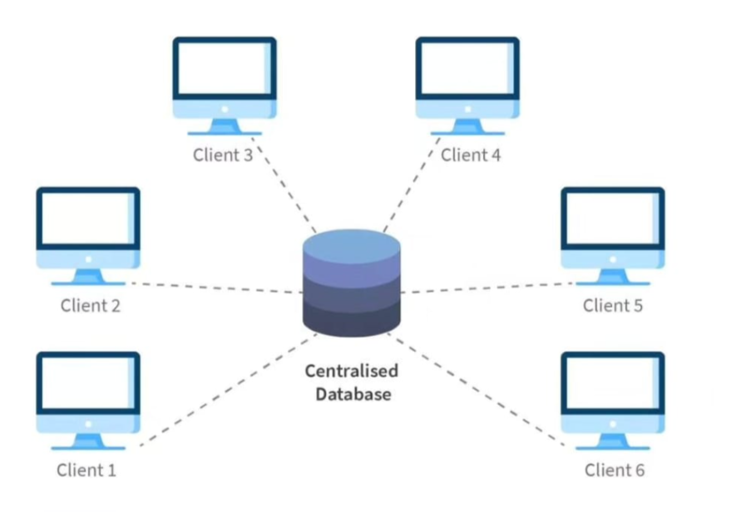
Centralized database: it is a collection of information at a single location accessible from numerous points. All the data is stored and managed at a single, centralized location/server. The basic role of a centralized database management system is to provide facilities and give access to all the connected computers which fulfill all requirements requested by any single node. In this case, we have a single database and multiple users located at different locations.

Slide 28
Commercial database: This type of database requires users to pay a given amount of money in order to access data from database, since they have been created for business purposes. In contrast to open source databases, commercial databases can be accessed or modified by only by authorized users. Eg. Oracle, IBM DB2

Slide 29
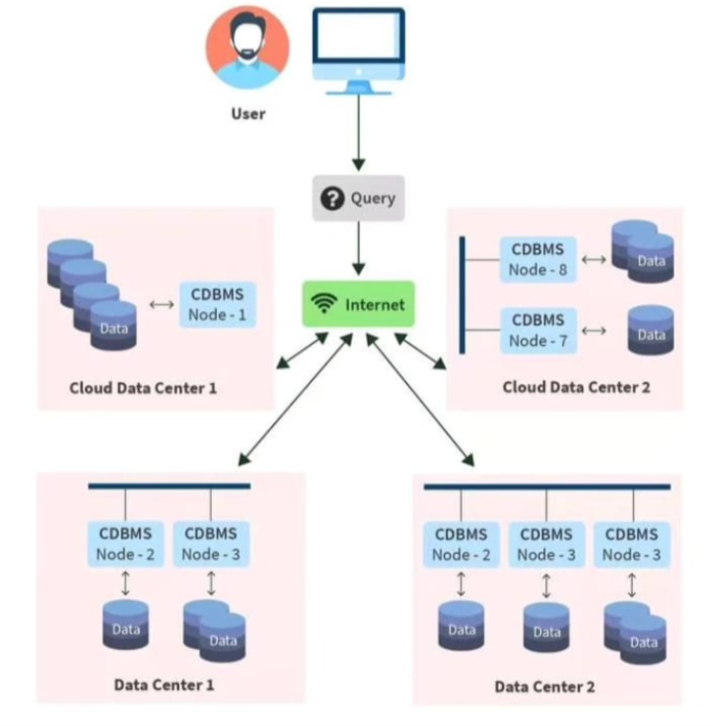
Cloud database: it is a database built, deployed and accessed in a cloud (virtual) environment where, users will be accessing data privately, publicly or using a hybrid mode. It is created with a purpose to help organize, store and manage data within an organization.

Slide 30
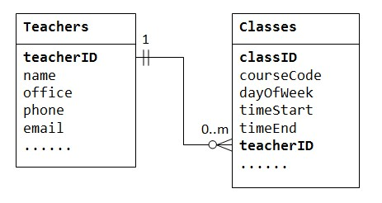
Relational database: it is a collection that organizes data into tables (or relations) comprising rows (records/tuples) and columns (attributes); where each table represents an entity and a row represents a unique instance of that entity. It is called relational database because there exist a predefined relationship between a table and another table.

Slide 31
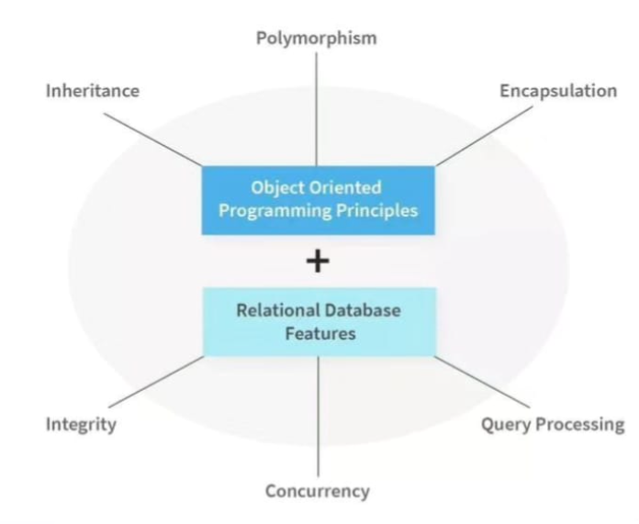
Object Oriented database (OODB): this type of database bases its functionalities on the principles of object oriented programming (oop). In other words, it is designed to store, manage, and retrieve data a way that is aligned with oop. In object oriented database, data is stored as objects, and objects are self-contained units that contain both data and the operations that can be performed on that data. OODB implements OOP concepts such as classes of objects, object identity, polymorphism, encapsulation and inheritance.
Note: The object oriented Database is more preferable for efficient representation and management of complex data structures and relationships.

Slide 32
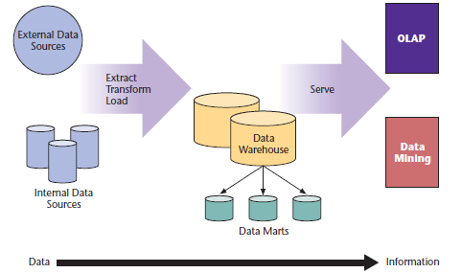
Data Warehouse: A data warehouse stores data that have been extracted from the various operational, external, and other databases of an organization. It is a central source of the data that have been cleaned, transformed, and cataloged so that they can be used by managers and other business professionals for data mining, online analytical processing, and other forms of business analysis, market research, and decision support.

Slide 33
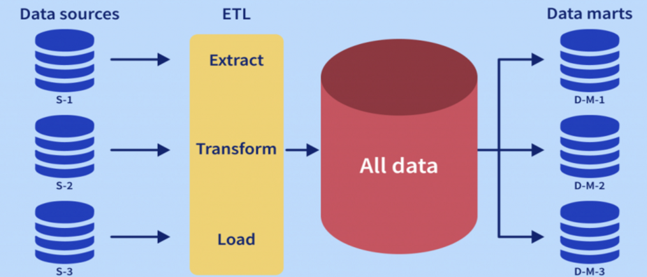
Data Mart: Data warehouses may be subdivided into data marts , which hold subsets of data from the warehouse that focus on specific aspects of a company, such as a department or a business process.

Slide 34

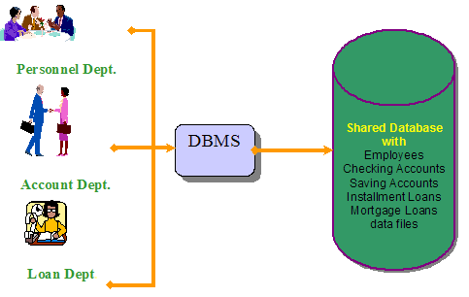
Database Management System
Database Management System: The DBMS is a computer program used to create, manipulate and administer the database.The DBMS receives requests (queries) encoded in SQL (Structured Query Language) and translates those queries into actions on the database.
The role of a DBMS is to:
Create database; Create tables;
Create supporting structures (e.g indexes);
Read database data;
Maintain database structures;
Enforce rules;
Control concurrency;
Modify (insert, update, or delete) database data;
Provide security;

Slide 35

Disadvantage of DBMS
Complexity
Size
Cost of DBMS
Additional hardware costs
Cost of conversion
Cost of Staff Training
Appointing Technical Staff
Database Damage

Slide 36

Examples of DBMS
Oracle
Filemaker
IBM DB2
Ingres
Interbase
Microsoft SQL Server
Miscrosoft Access
Microsoft Foxpro
Borland Paradox
Sybase
MySQL
PostgreSQL
Hyperfile

Slide 37

Components of DBMS
Users interacting with database
Software
Hardware
Data
Procedures

Slide 38

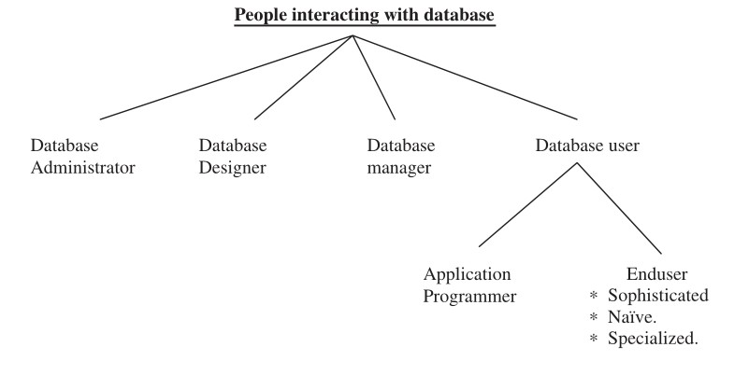
Users interacting with database

Slide 39
Users interacting with database
Database administrator is responsible for
Authorizing access to the database, coordinating and monitoring its use, acquiring hardware and software resources as needed, Backup and recovery.
Database designer is responsible for
Identifying the data to be stored in the database and choosing appropriate structure to represent and store the data.
Database manager: Database manager is a program module which provides the interface between the low level data stored in the database and the application programs and queries submitted to the system

Slide 40
Users interacting with database
Database users : Database users are the people who need information from
the database to carry out their business responsibility.
2 broad categories: Application programmer and end users Application programmers: Application programmers write application programs and interact with the data base through host Language like Pascal, C and Cobol
End users
Sophisticated End Users : they interact with the system without writing programs,They form requests by writing queries in a database query language.
Specialized end users : they write specialized database application
that does not fit into data-processing frame work.
Naïve end user interact with the system by using permanent application program

Slide 41

Software
Controls the organization, storage, management, and retrieval of data in
a database.
It includes operating system, network software, and the application programs which encompasses the physical interconnections and devices required to store and execute (or run) the software.
Software consists of a machine language specific to an individual processor.
It is usually written in high-level programming language more efficient for
humans to use .

Slide 42


Hardware
Hardware of a system can range from a PC to a network of computers.
It also includes various storage devices like hard discs and input and output
devices like monitor, printer, etc.
Data
Data stored in a database includes numerical data such as whole numbers and floating point numbers and non numerical data such as characters, date, or logical data.
More advanced systems may include more complicated data entities such as
pictures and images as data types.

Slide 43

Procedures
Procedures refer to the instructions and rules that help to design the
database and to use the DBMS.These may include:
Procedure to install the new DBMS.
To log on to the DBMS.
To use the DBMS or application program.
To make backup copies of database.
To change the structure of database.
To generate the reports of data retrieved from database.

Slide 44

DBMS architecture
There is 3 level
External level
Conceptual level
Internal level
Objective of this three level architecture
It has the objective of separating each user view of data from the way the
database is physically represented.
The internal structure of database should be unaffected while changes
to the physical aspect of storage
The DBA should be able to change the conceptual structure of database without affecting all other users.

Slide 45
The external or view level includes a number of external schemas or
user views.
Each external schema describes the part of the database that a particular
user group is interested in and hides the rest of the database from that user group.
each external schema is typically implemented using a representational data model, possibly based on an external schema design in a high-level data model.

Slide 46
The conceptual level has a conceptual schema, which describes the structure of the whole database for a community of users.
It hides the details of physical storage structures and concentrates on describing entities, data types, relationships, user operations, and constraints. Usually, a representational data model is used to describe the conceptual schema when a database system is implemented.
Example: University database
Students(sid: string, name: string, login: string, age: integer, gpa: real)
Faculty(fid: string, fname: string, sal: real)
Courses( cid: string, cname: string, credits: integer) Rooms(rno: integer, address: string, capacity: integer) Enrolled (sid: string, cid: string, grade: string) Teaches(fid: string, cid: string)
Meets_In( cid: string, rno: integer, time: string)

Slide 47
The internal level has an internal schema, which describes the physical storage structure of the database.
The physical schema summarizes how the relations described in the conceptual schema are actually stored on secondary storage devices such as disks and tapes
It uses a physical data model and describes the complete details of data
storage and access paths for the database.

Slide 48
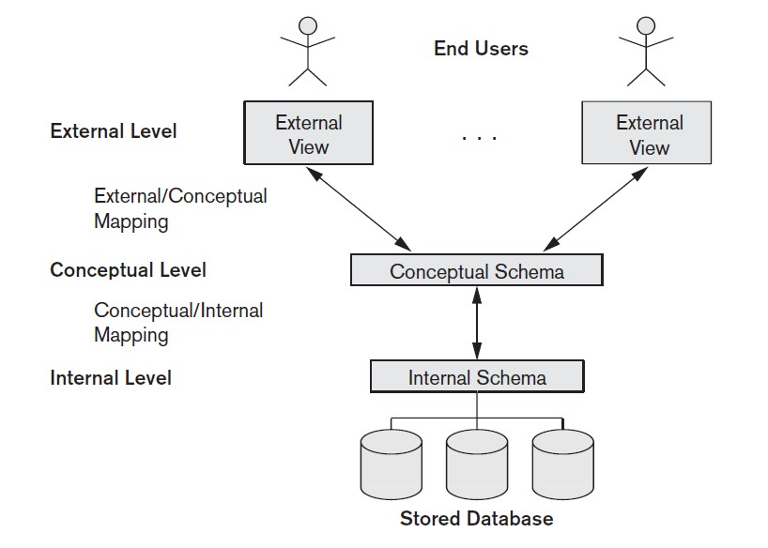

Slide 49

Data independence
Data dependence can be defined as the capacity to change the schema at one level of a database system without having to change the schema at the next higher level.
Logical Data Independence:The capacity to change the conceptual schema without having to change the external schemas and their application programs.
Physical Data Independence:The capacity to change the internal schema
without having to change the conceptual schema.
When a schema at a lower level is changed, only the mappings between this schema and higher-level schemas need to be changed in a DBMS that fully
supports data independence.The higher-level schemas themselves are unchanged. Hence, the application programs need not be changed since they refer to the external schemas.

Slide 50

DBMS languages
Data Definition Language (DDL): Used by the DBA and database designers to specify the conceptual schema of a database. In many DBMSs, the DDL is also used to define internal and external schemas (views). In some DBMSs, separate storage definition language (SDL) and view definition language (VDL) are used to define internal and external schemas.

Slide 51
DBMS languages
Data Manipulation Language (DML): Used to specify database retrievals and updates.
DML commands (data sublanguage) can be embedded in a general- purpose programming language (host language), such as COBOL, C or an Assembly Language.
Alternatively, stand-alone DML commands can be applied directly (query language).

Slide 52
DBMS languages
High Level or Non-procedural Languages: e.g., SQL, are set-oriented and specify what data to retrieve than how to retrieve. Also called declarative languages.
Low Level or Procedural Languages: record-at-a-time; they specify how
to retrieve data and include constructs such as looping.

Slide 53

Data model
A Data Model is a collection of concepts that can be used to describe the structure of a database. By structure of a database, we mean the data types, relationships, and constraints (NOT NULL , UNIQUE , PRIMARY KEY, FOREIGN KEY etc) that apply to the data
It provides the necessary means to achieve data abstraction

Slide 54

Categories of data modeling
Hierarchical model
Network model
Relational model
Multidimensional model
Object-oriented database model
Entity-relationship model

Slide 55

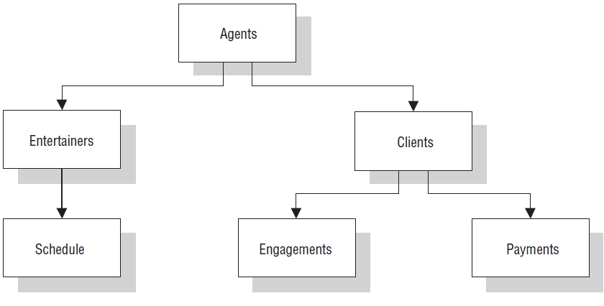
Hierarchical data Model
In hierarchical data model, data is organized into a tree like structure with each record is having one parent record or root and many children.
The hierarchical database model mandates that each child record has only one parent, whereas each parent record can have one or more child records.
In order to retrieve data from a hierarchical database the whole tree needs to be traversed starting from the root node.

Slide 56

Advantages of Hierarchical Model
Easy to understand
Performance is better than relational data model
Disadvantages of Hierarchical Model
Difficult to access values at lower level
Deletion of parent node result in deletion of child node forcefully
Extra space is required for the storage of pointers
One parent per child.
Navigation system is complex.
Many too many relationships not supported.
Data independence.

Slide 57

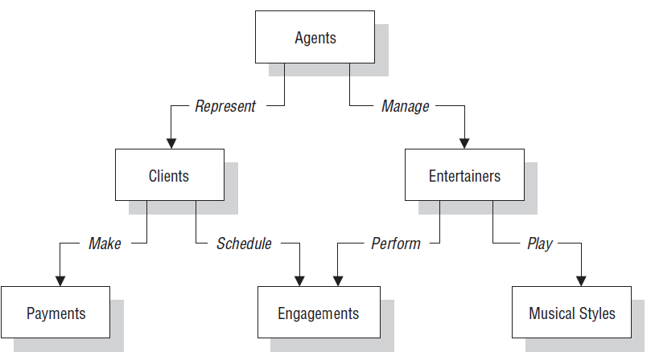
Network model
In network models, the entities are organized in graph, in which some entities can be accessed through several paths.
Network Model is same as hierarchical model except that it has graph-like structure rather than a tree-based structure.
Unlike hierarchical model, this model allows each record to have more than one parent record.

Slide 58
 Advantages
Network Model is able to model complex relationships and represents semantics of add/delete on the relationships.
Fast data access
It also allows users to create queries that are more complex than those they created using a hierarchical database.
Disadvantages
A user has to be very familiar with the structure of the database in order to work through the set structures.
It is that it is not easy to change the database structure without affecting the application programs that interact with it.

Slide 59

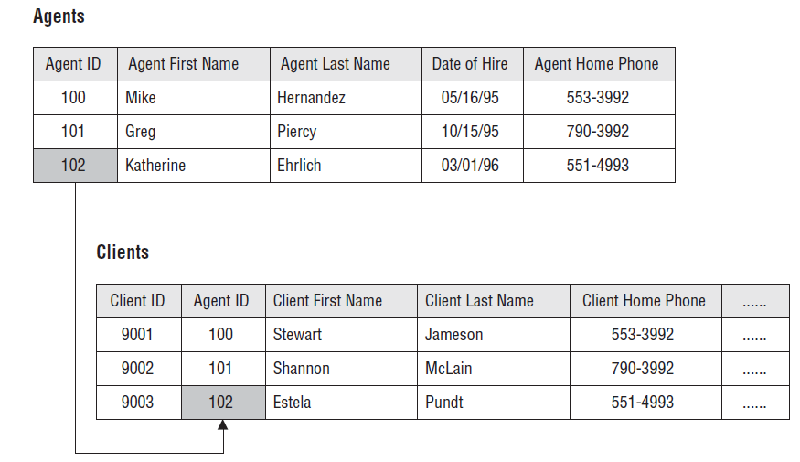
Relational model
Relational model: It is the most widely used of the three database structures. It is used by most microcomputer DBMS packages, as well as by most midrange and mainframe systems. In the relational model, all data elements within the database are viewed as being stored in the form of simple two-dimensional tables , sometimes referred to as relations . The tables in a relational database are flat files that have rows and columns

Slide 60

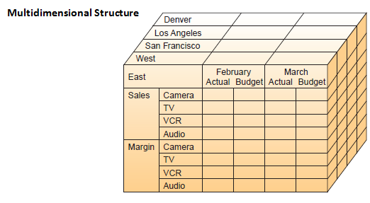
Multidimensional model
Multidimensional model: It is a variation of the relational model that uses multidimensional structures to organize data and express the relationships between data. You can visualize multidimensional structures as cubes of data and cubes within cubes of data. Each side of the cube is considered a dimension of the data. The Figure below is an example that shows that each dimension can represent a different category, such as product type, region, sales channel, and time.

Slide 61



Object-oriented model
Object-oriented model: It is considered one of the key technologies of a new generation of multimedia Web-based applications. As The Figure below illustrates, an object consists of data values describing the attributes of an entity, plus the operations that can be performed upon the data. This encapsulation capability allows the object-oriented model to handle complex types of data (graphics, pictures, voice, and text) more easily than other database structures. The object-oriented model also supports inheritance ; that is, new objects can be automatically created by replicating some or all of the characteristics of one or more parent objects.

Slide 62
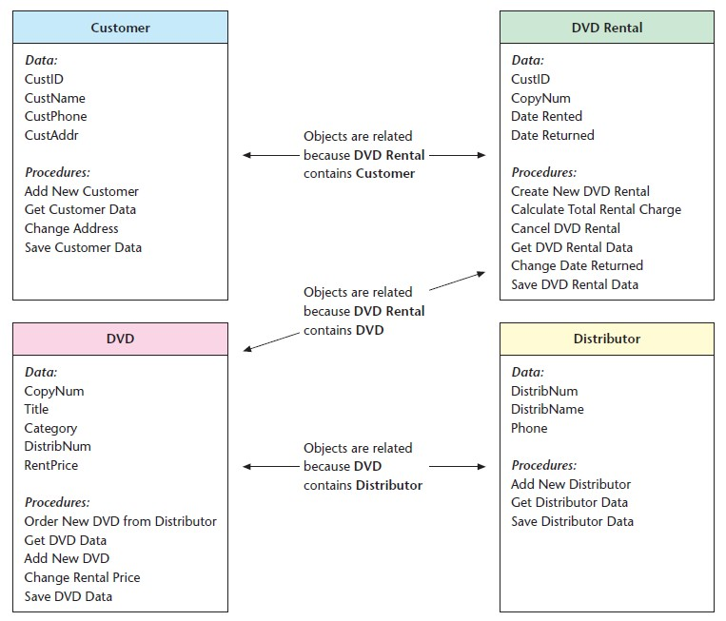
Object-oriented model

Slide 63

Disadvantages OO model
It is not widely developed and complete to use it in the database systems. Hence it is not accepted by the users.
It is an approach for solving the requirement. It is not a technology. Hence it fails to put it in the database management systems.

Slide 64




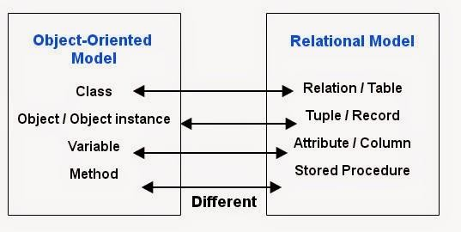
Difference between Object-oriented database Model & Relational Model

Slide 65



Entity-Relationship Model
An entity-relationship model is a detailed, logical, and graphical representation of the data for an organization or business area. It is a model of entities in the business environment, the relationships or associations among those entities, and the attributes or properties of both the entities and their relationships. It defines the conceptual view of a database and considered as a good option for designing databases
The basic entity-relationship modeling notation uses three main constructs: data entities, relationships, and their associated attributes. Several different ERD notations exist, and many CASE tools support multiple notations. We have adopted an annotation that might not be common, but easy to understand.

Slide 66


59

